Slide 1

RAG PROJECT
JARIAN DEL VALLE
JAVIER DASTAS

Slide 2
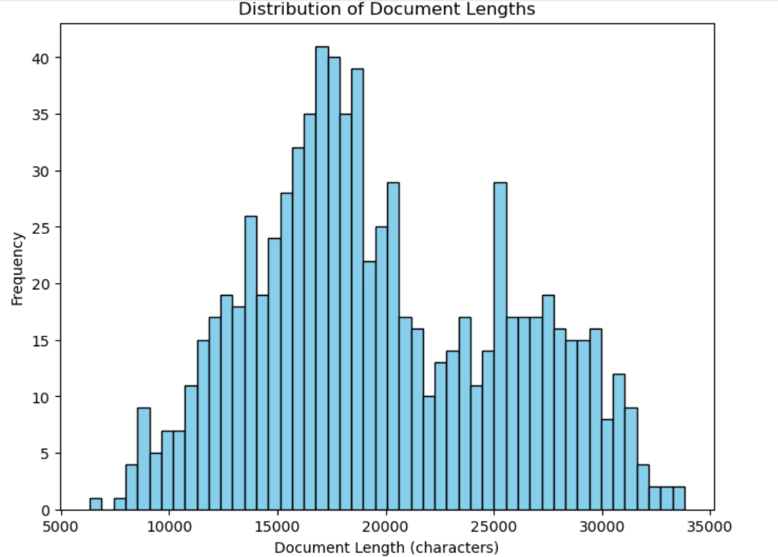
EXPLORATORY DATA ANALYSIS (EDA)

Slide 3
EXPLORATORY DATA ANALYSIS (EDA)
Could present challenges due to content length variety, may exceed allowed token limit when combining chunks
Suitable data set for query retrieval due to chunked format

Slide 4
Extract-Tranform-Loading (ETL)
Recursive Text Splitter, chunk size 1000 and chunk overlap 200 (within recommended 10 – 20% overlap)
Iterate through the text file to perform splitting
Batch insert into ChromaDB

Slide 5
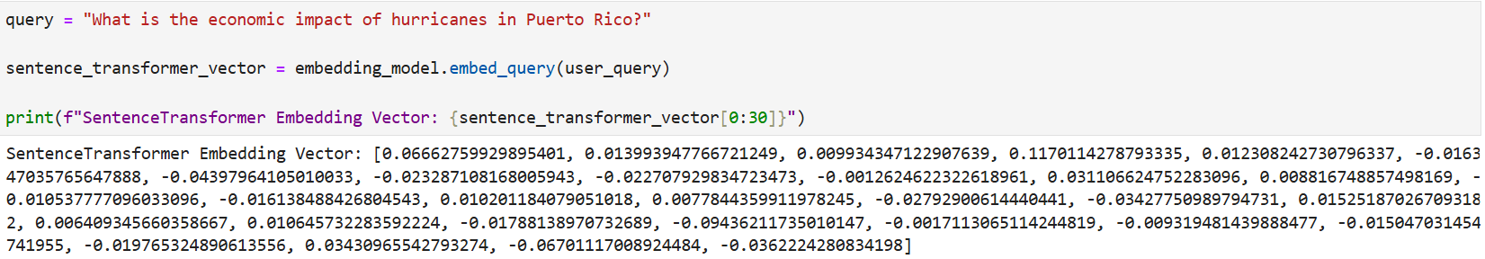
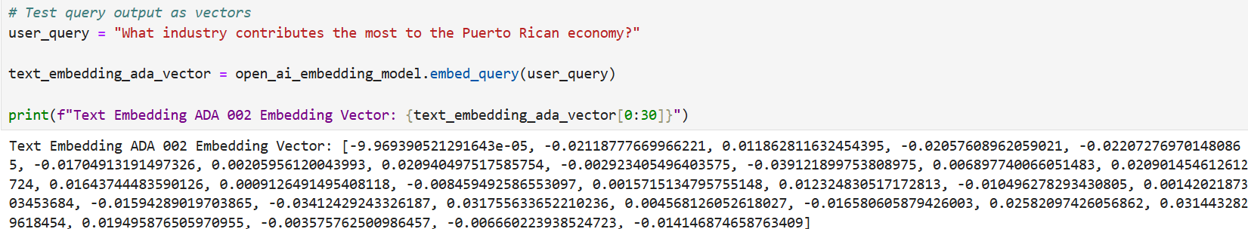
EMBEDDINGS
Initial trial: Hugging Face embeddings with model- "sentence-transformers/all-MiniLM-L6-v2“
Second trial: Open AI Embeddings with model- "text-embedding-ada-002"

Slide 6
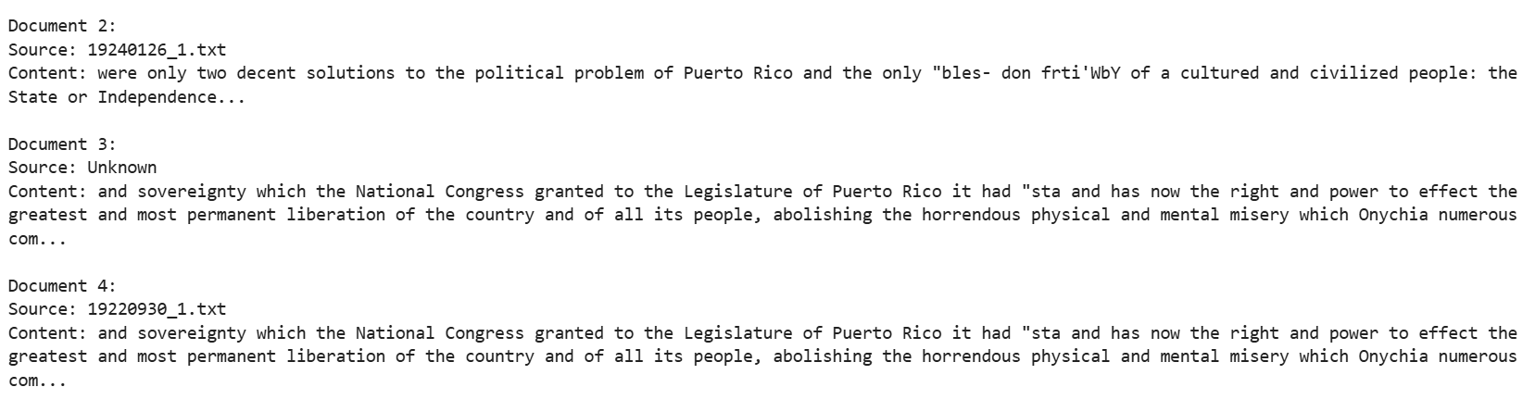
RETRIEVAL
Retrieval with ChromaDB-Hugging Face Embedding with Sentence Transformers

Slide 7
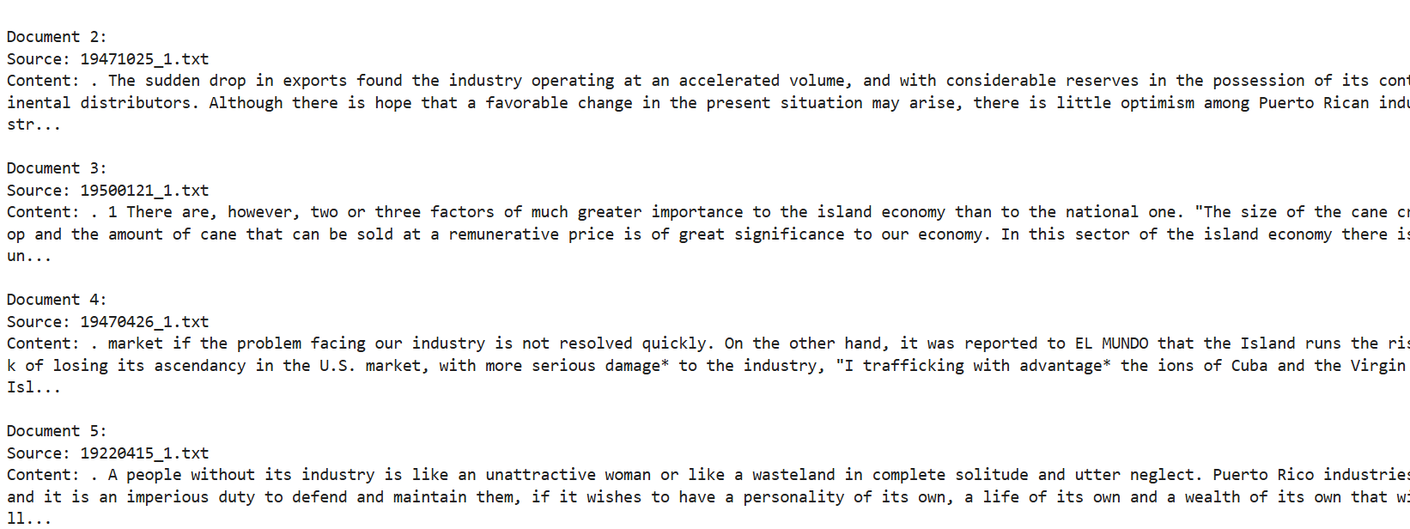
RETRIEVAL
Retrieval with ChromaDB- OpenAI Embedding with Text Embedding ADA 002

Slide 8
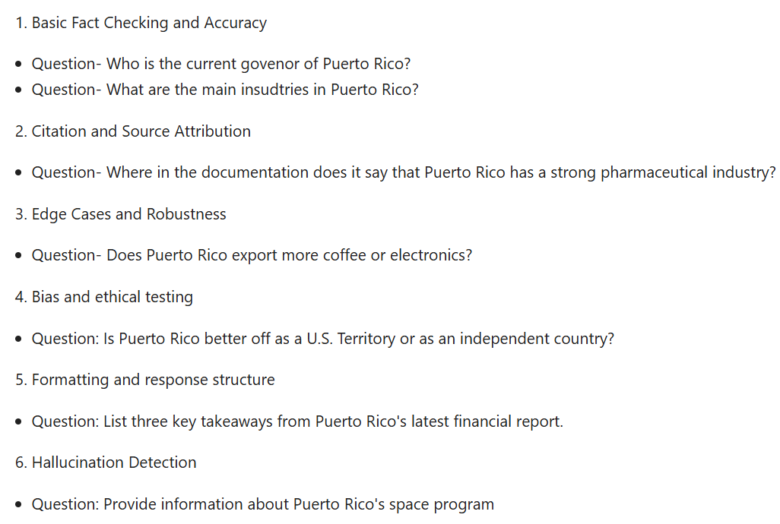
MODEL EVALUATION- QUERY

Slide 9
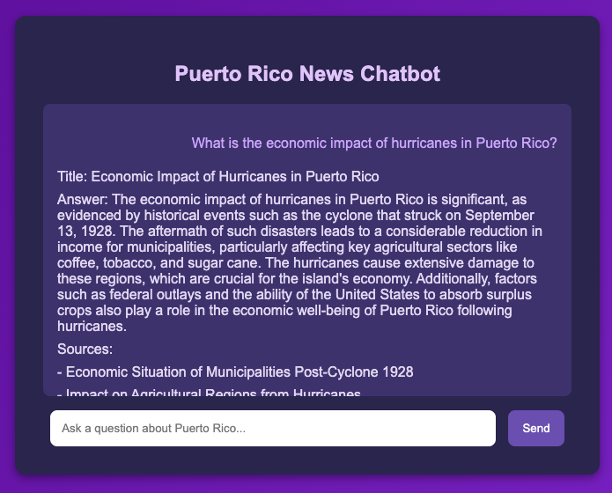
RAG DEPLOYMENT
Implementation
Linode Cloud Service
Ubuntu 24.0 Server OS
Back-end: Flask (API) + NGINX
Front-end: Flask-Template
Requirements
flask 3.1.0
openai 1.61.1
langchain_chroma 0.2.1
langchain_huggingface 0.1.2
langchain_openai 0.3.4
http://dsmlbootcamp.org

Slide 10

THANK YOU
JARIAN DEL VALLE
JAVIER DASTAS

